Slide 1
Chapter 8
Lists

Slide 2
What’s a list?
A group of values put inside a single variable
Lets us call in a load of values with a single variable
Makes the code more concise, simple, easier
Format: list1 = [ a, b, c ]

Slide 3
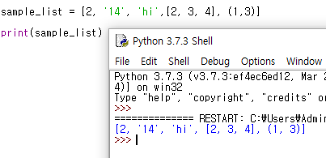
Things that can go inside a list
strings
numbers
lists
*tuples
etc

Slide 4
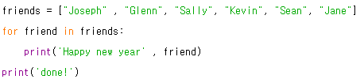
When is it used?
List is commonly used with loops
List: stores multiple values
Loops: suitable for processing multiple values

Slide 5
Try
We have a list of 5 numbers, 19, 23, 16, 27, 84
How can we create a list where each variable is five times larger than the original list?

Slide 6
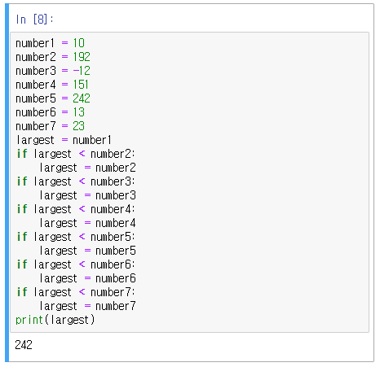
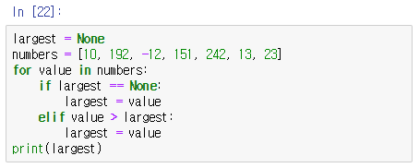
When is it used?

Slide 7
Strings vs Lists
String
List
immutable
cannot fix
len() = number of characters
string = “hello”
len(string) = 5
mutable
can fix wherever you want
len() = number of values
list = [1, 2, ‘hi’ , [2, 4, 5]]
len(list) = 4

Slide 8
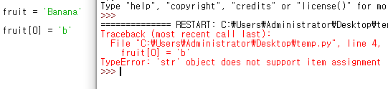
Fixing a list
Fixing a string

Slide 9
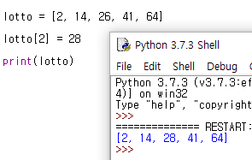
Fixing a list
Fixing a list

Slide 10

The Range Function
returns a list of numbers from 0 to a parameter
range(4) == [0, 1, 2, 3]
used with len()

Slide 11
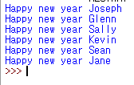
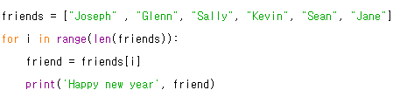
Diverse Methods for Solving a Problem

Slide 12

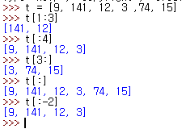
Concatenating/Slicing a list
Concatenating
Slicing
t[a:b] = from a to b

Slide 13
Methods used in Lists
Append
Count
Extend
Index
Sort
Insert
etc

Slide 14
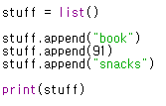
Creating a List
We can create an empty list and add elements using the append method
The appended elements go to the end of the list

Slide 15

Checking if in List
To check if a certain variable is in a list, we use in

Slide 16
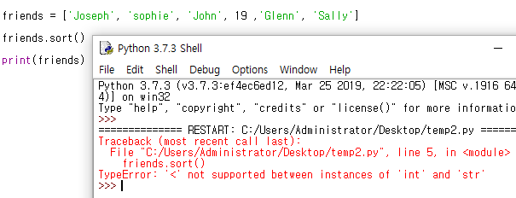
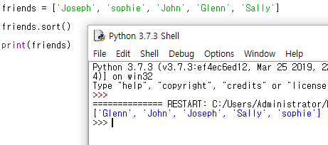
Sorting Variables
We can rearrange the order of variables
If all variables are the same type
In alphabetical / numerical order
Capital > Lower case

Slide 17
Try
Try arranging the given lists, see what happens
list1 = ['Gray', 'Purple', 'red', 'black', 'Yellow', 'green']
[4, 'hi', 15, 'ag']

Slide 18
Built-in Functions
nums = [3, 41, 12, 8, 53, 13]
Try:
len(nums) > number of variables
max(nums) > the largest number
min(nums) > the smallest number
sum(nums) > sum of numbers

Slide 19
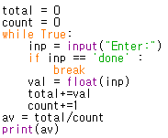
Getting the Average 1
Using all that we learned, we can make a program that gets the average

Slide 20
Getting the Average 2
Let’s make a same program using a list
len(list)
sum(list)

Slide 21
Getting the Average 2
numlist = list()
while True:
inp = input("Enter:")
if inp =='done':
break
val = float(inp)
numlist.append(val)
average = sum(numlist)/len(numlist)
print(average)

Slide 22
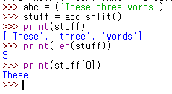
Strings & Lists
Strings and Lists are often used together

Slide 23
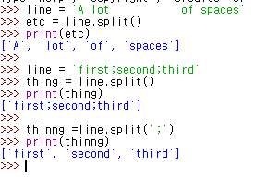
String parameters of split() : indicates where the string should be sliced

Slide 24
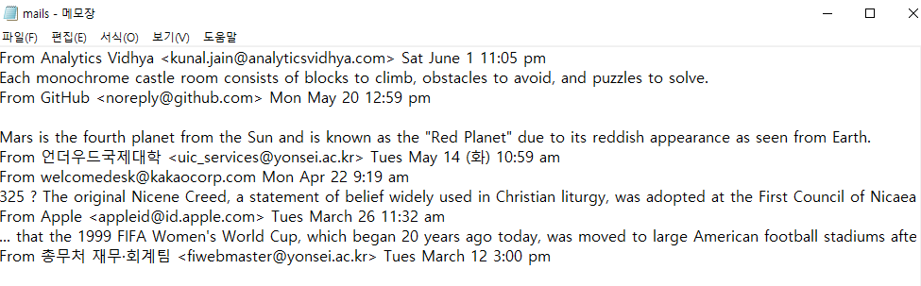
Exercise
Let’s read the file mails.txt
Remove all junk lines
Make each lines of email into a list
See from which group the mails are coming from

Slide 25


Slide 26
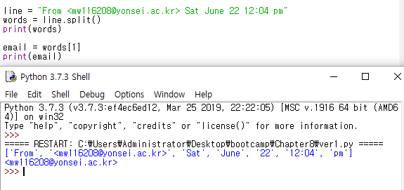

Slide 27
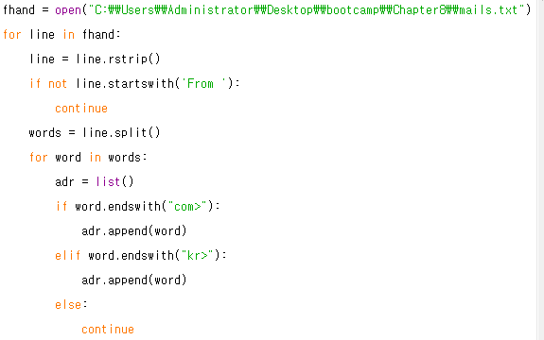

Slide 28
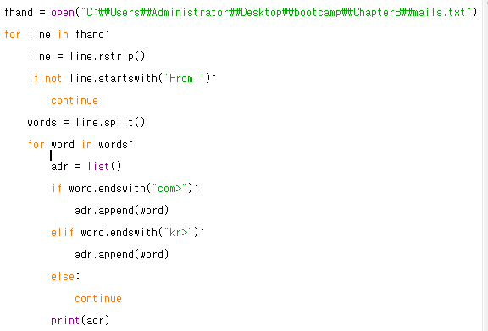

Slide 30
Try yourself
From mails.txt, get all the Months
From mails.txt, get all the hours
12:30

